Slide 1

E-ComHub:
Your Go-To Electronics Marketplace
Seamlessly Shop Electronics and Accessories Anywhere, Anytime
01

Slide 2

Problem Statement
Difficulty finding reliable platforms for diverse electronics and accessories.
Lack of user-friendly interfaces and seamless navigation.
Limited payment options leading to abandoned carts.
2

Slide 3
Solution
A fully functional e-commerce platform tailored for electronics and accessories.
Features responsive design for a seamless experience across devices.
Integrated secure payment gateways for ease of transactions.
3

Slide 4

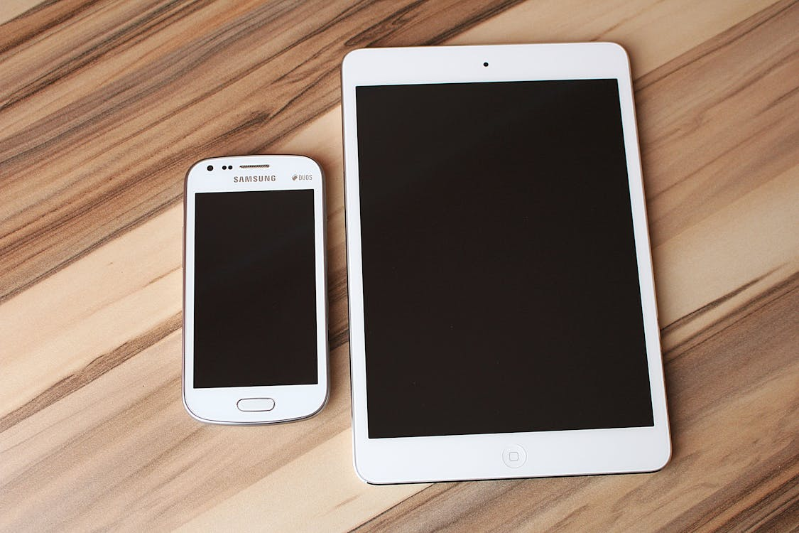

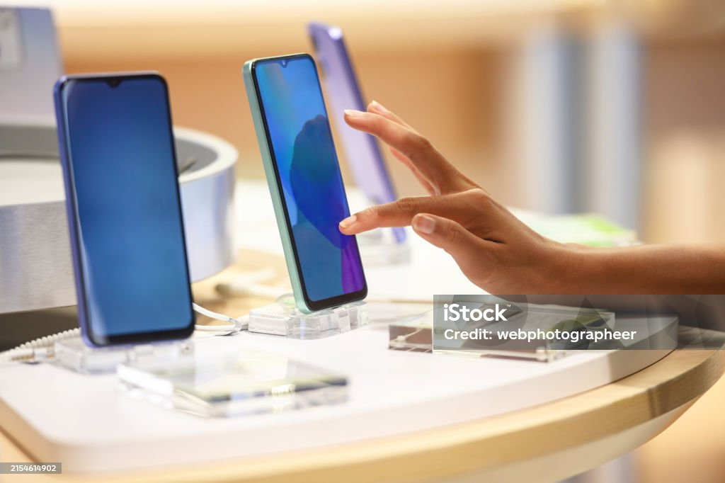
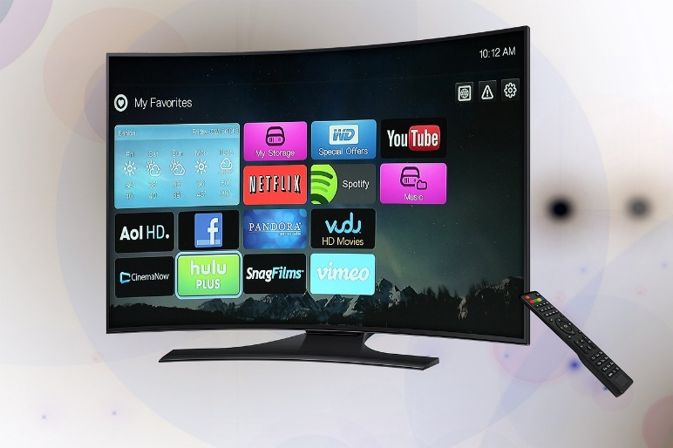

Products
Electronics gadgets, watches, phones, headphones, iPads, water dispensers, and phone accessories.
Intuitive UI/UX design for effortless browsing.
Robust payment integration, including credit/debit cards and wallets.
04

Slide 5
Target Market
2 out of 5:
Customers report a lack of trust in current platforms for electronics
95%
Our website ensures customer satisfaction through user-centered design.
123 million
123 million: Projected user reach within the first three years
5

Slide 6
Target Market
Iech Enthusiasts
20%
Small Business Owners
20%
Tech Enthusiasts (20%)
- Small Business Owners (20%)
- Gadget Lovers (20%)
- Professioanals & Students (20%)
- General Shoppers (20%)
Market Size: $500 billion global electronics market.
Gadget Lovers
20%
General Shoppers
20%
Professional Students
20%
6

Slide 7

Competitors
Key Competitors: Amazon Electronics, Best Buy, Flipkart.
Why We Stand Out:
Enhanced UI/UX tailored for electronics.
Competitive pricing and exclusive deals.
Personalized recommendations based on user behavior.
7

Slide 8
Competitive Advantage
Responsive design for mobile and desktop users.
Integrated features like live chat support and order tracking.
Community-driven reviews for informed purchases.
8

Slide 9
Project Traction
Tasks
Month 1
Month 2
Month 3
Month 4
Month 5
Milestones Achieved:
Prototype completion.
Initial user testing with positive feedback.
Future Goals:
Launch by Q3 2025.
Integrate additional payment options like cryptocurrency.
9

Slide 10
Business Model
Revenue Streams:
Direct sales of products.
Subscription for premium services (priority delivery, exclusive discounts).
Affiliate marketing with top brands.
10

Slide 11
Go-To Market Strategy
Social media campaigns targeting gadget enthusiasts.
Partnerships with electronics brands for exclusive deals.
Influencer endorsements and tech reviews.
11

Slide 12
Social Impact
Promotes digital inclusivity through responsive design.
Reduces carbon footprint with paperless transactions.
Supports SDGs: Innovation and Infrastructure (Goal 9), Responsible Consumption (Goal 12)
12

Slide 13
Our Ask
Funding Request: $500,000
Utilization:
50%: Platform enhancement and maintenance.
30%: Marketing and user acquisition.
20%: Team expansion and operations.
13

Slide 14

Project Owner
Nwachukwu Chidiebere
CEO
14

Slide 15



Thank you!
Email: kingdaveo22@gmail.com
Chidiebere David wester
+2348127234228
@kingdaveo22
15

